Slide 1


Name
Date
Notes:
Over the next decade, the explosion of data will introduce not only massive challenges for IT, but massive opportunities for business.

Slide 2








What’s Driving The Data Deluge?
Video Rendering
FACEBOOK GROWS BY
250 MILLION
PHOTOS / DAY
Video Surveillance
Mobile Sensors
Social Media
READING METERS EVERY 15 MINS. IS 3,000X MORE
DATA INTENSIVE
Medical Imaging
Gene Sequencing
COST TO SEQUENCE
ONE GENOME
HAS FALLEN FROM $100M IN 2001 TO $10K IN 2011
Geophysical Exploration
Smart Grids
Notes:
The sources of information are expanding. Many new sources are machine generated. It’s also big files (siesmic scans can be 5TB per file) and massive numbers of small files (email, social media).
Leading companies for decades have always sought to leverage new sources of data, and the insights that can be gleaned from those data sources, as new sources of competitive advantage.
More detailed structured data
New unstructured data
Device-generated data
But big data isn’t only about data, a comprehensive big data strategy also needs to consider the role and prominence of new, enabling-technologies such as:
Scale out storage
MPP database architectures
Hadoop and the Hadoop ecosystem
In-database analytics
In-memory computing
Data virtualization
Data visualization

Slide 3
How Can Big Data Transform Your Business?
New Source of Customer, Product and Operational Insights
Today’s Decision-making
Big Data Decision-making
“Rearview Mirror” hindsight
Less than 10% of available data
Incomplete, disjointed, inaccurate
“Forward-looking” insight
Exploit all data from diverse sources
Real-time, correlated
Notes:
More than just about technology and data, Big data is a business transformational enabler – it’s an industry inflection point.
Big data has the potential to transform the very essence of how a company runs its business, interfaces with its customers and outflanks its competition
Transform the business from a “rear-view mirror” perspective, to a forward-looking, predictive windshield that guides business decisions
That leverages less than 10% of the available enterprise data, to a business model that extracts every last ounce of insights across and between all available data
Relying upon data that is incomplete, disjointed and sometimes even inaccurate, to a strategic data asset that is available in real-time and correlated across a variety of data sources

Slide 4

Big Data Transforms Retail Banking
Reduce customer attrition
Proactive customer contact
Increase revenue per customer
Recommend products based on purchasing trends
Improved operational efficiency
Staff branches based on “who” banks “where”
“We leveraged the profitability system to analyze historical data and create a new set of assumptions for our loan officer.”
Notes:
One of our customers are using Big Data to transform their business
Reduce customer attrition – Developed model that scores a customer’s likelihood of leaving the bank based on behavioral trends
Increase uptake on new products – The bank developed a product recommendation engine based on product mixes and profitability. Employees were able to recommend products that would guarantee profitability. Customers that bough “unrecommended products” or those who didn’t buy any additional products proved to be less profitable for the bank. Customers that bought “recommended products” such as ATM and personal money market accounts proved to be more profitable for the bank.
Operational Efficiency: They have continued to leverage the power of greenplum to improve operations. In this example they gathered up transaction data that we hadn’t loaded into the warehouse before and studied where the customers were really doing business versus where they opened their account. This Google mashup shows how associated branch ownership of a customer’s account versus where the customer really did business. We used this analysis to close branches and change our staffing models.
Customer: Zions Bancorporation
Zions Bancorporation one of the nation’s premier financial services companies, consisting of 17 banks and companies. When faced with the challenge of massive data growth and limited resources, Zions came to Greenplum for tangible business solutions. Because the company’s growth strategy focuses on utilizing Big Data - high-volume, varied data assets, Zions needed a solution to engage customers in new ways, generate business demand and increase revenue streams. With Greenplum, they were able to cut database loading, accelerate queries in seconds, free up DBAs to spend more time on data analysis versus maintenance and improve CRM.
Challenges:
• Manage exponential data growth and growing customer base
• Oracle performance issues – unable to scale
• Reallocate DBA time from system maintenance to developing business solutions
• Develop predictive analytics that drive help the bank get “closer to their customers”
Solutions:
• Greenplum Database
• Greenplum Professional Services
• Alpine Miner
Key Benefits:
• Enterprise-wide database loading cut from 24 hours to 30 minutes
• Data warehouse queries answered in seconds rather than hours
• Power users spend 30 percent more time on data analysis
• Increased net profitability of individual customer accounts
Additional Details:
http://www.greenplum.com/sites/default/files/Zions_Bancorporation_case_study_0.pdf
The company’s growth strategy focuses on utilizing Big Data - high-volume, varied data assets - to engage customers in new ways, generate business demand and increase revenue streams. Zions believes that financial services companies that know the most about their customers and respond to this information quickly will have a strong competitive advantage. Zions must also satisfy an array of data-intensive privacy and regulatory requirements. The increasing volume, variety and velocity of data at Zions Bancorporation put analytic demands on its existing Oracle data warehouse that it simply could not handle.
Clint Johnson, Zions’ Director of Data Warehousing and Analytics, says, “Our monolithic Oracle data warehouse was struggling to process our growing data assets, so we had to break it up into smaller data marts that began proliferating all over the place. Without a centralized resource, it was more difficult for analysts to understand risk associated with business decisions. Queries were taking hours or all night to execute. And our database administrators spent most of their time on maintenance and troubleshooting.”
…Johnson recalls, “As the banking crisis was unfolding, we leveraged the profitability system to analyze historical data and create a new set of assumptions for our loan officers. It used to take seven hours to reprocess a month’s worth of data. With Greenplum we can crunch through two years of history in 7 ½ hours.”

Slide 5






The Journey To Big Data
1
2
3
All Data Faster Answers
Elastic & Scalable
Data Science Collaboration
Self-Service
Real Time Decisions
New Applications
Data Monetization
Big Data Enabled Apps
Agile Process & Tools
Analytic Engines
Analytics Engines
Analytic Productivity Platform
Cloud Infrastructure
Big Data Infrastructure Technology Focus
Agile Analytics People & Productivity Focus
Predictive Enterprise Application Focus
Notes:
We’ve found our early adopter customer use a common approach to their journey to big data.
First, they built on an infrastructure foundation that consists of elastic and scalable storage as well as analytics that can access all types of data.
Next, they focus on improving the analytics process
Lastly, they embed Big Data into their applications and enable actionable insight.
We found that customers who’ve used this approach have been able to transform into a more predictive enterprise.

Slide 6
Big Data Apps Require Big Data Storage
Your Approach To Enterprise Storage Must Change
Scale Up, Manual
Scale Out, Automated
Storage Islands
More Capacity, More Admins
Performance Optimization “Whack-A-Mole”
One Storage Pool To 10+PB
More Capacity, Same Admins
Linear Performance Scalability
Notes:
Big data applications require new approach to storage
Must be scale out, highly automate, and move to shared pools to deliver capacity w/ same admin.
Capacity, performance, IOPS= must grow linearly without adding tons of people cost.
BELOW ARE NOTES ONLY, NOT FOR MONITOR:
Big Data applications require a new infrastructure. It can’t be scale up; it can’t be manual—it must be scale out and highly automated. This infrastructure needs to move past storage islands to shared pools where more capacity can be delivered with the same admins, and with no scaling of the TCO of the environment. Capacity, performance, and IOPS must grow linearly as those are added to the network.
This is what EMC is doing with the Isilon family.

Slide 7
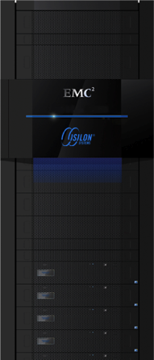
EMC Isilon.
Record Scalability.
Record Capacity.
Remarkable Simplicity.
Notes:
Introduced in March
Isilon S200 = linear throughput scalability = 2X increase in megabytes/second to >80GB/second
BELOW ARE NOTES ONLY, NOT FOR MONITOR:
This is what EMC is doing with the Isilon family. The EMC Isilon S Series, the next generation of the Isilon platform, was introduced in March 2011 to demonstrate record scalability and remarkable simplicity simultaneously.
Isilon S200 has linear throughput scalability with 2X increase in the megabytes per second to over 80 gigabytes per second. Similarly, there’s a dramatic increase in transaction scalability—again, a linear increase in the IOPS of the platform to over 1.2M SPEC FS-like capabilities.

Slide 8


Big Data Transforms Life Sciences
Fast access to all data
Scale to 12PB with linear performance
Collaborate on groundbreaking research
Discover new treatments
Reduce the spread of disease
“We’ve been able to grow a single file system to a PB in less than a year & maintain the throughput necessary to advance our research.”
Notes:
The Broad Institute, is one of the United States’ largest sequencing centers and a global leader in genomics and bioinformatics. They perform genome sequencing to develop treatments for diseases such as leukemia, rheumatoid arthritis and more. These sequencing applications that contains >1 trillion raw images.
In 2011, Broad researchers use whole-genome sequencing to trace the path of the 2011 summer's E. coli outbreak (image)
"Applications of next-generation DNA sequencing at the Broad Institute and elsewhere require an unprecedented amount of data to be stored and managed in a high-performance research and bioinformatics pipeline," said Matthew Trunnell, Manager of Research Computing at the Broad Institute. "With Isilon IQ, we've been able to grow a single file system to nearly a Petabyte in less than a year, while still maintaining the data throughput necessary to power our workflow and advance our research.”
Before we worked with them over 3 years ago, Broad was struggling with scaling their current storage environment to support the DNA sequencing application. The systems weren’t keeping up to their data growth.
We then offered them our scale out storage, Isilon which enabled to scale as their data grew from 1PB to today’s 12PB within 5 years!
EMC is helping Broad’s researchers to collaborate on massive amounts of genomic information in real-time and more efficiently identify correlations between genomic sequences.
Using Isilon clustered storage, this data can be directly stored and analyzed, enabling the Institute's scientists to access, process and store genomic data from one, easily accessible and highly reliable central storage repository.
http://www.isilon.com/press-release/isilon-iq-powers-data-storage-next-generation-dna-sequencing
Currently using nearly 10 petabytes of Isilon to power massive genomic sequencing operation
http://www.broadinstitute.org/blog/quiet-genome-new-cancer-gene-emerges

Slide 9


Big Data Transforms Movie Production
Improve collaboration and efficiency
Accelerate project completion
Enable maximum data availability
“With Isilon, leading-edge studios can scale performance and capacity in-line with changing project demands, accelerating productivity, while minimizing costs.”
Notes:
Customer: Laika Studios
LAIKA, the studio behind the Academy Award®-nominated Coraline, has deployed more than a petabyte of EMC Isilon® scale-out NAS as the primary storage platform for its end-to-end animation and computer graphics (CG) workflow, simplifying big data management to increase artist collaboration and accelerate project completion. By using Isilon scale-out NAS to consolidate its entire production workflow and scale its storage resources in-line with artists’ needs, LAIKA is seizing the big data opportunity and leading the way in a new era of media and entertainment.
Challenges:
Artists were waiting for render jobs to finish or content to migrate instead of focusing on the creative process
Workflows managed separately, which made management a hassle and limited productivity
Solutions:
Worked with Isilon channel partner IMT, to deploy three tiers of Isilon scale-out NAS:
High-performance 5400S for its IOPS-intensive compositing workflow
10000X-SSD for metadata-intensive computer graphics applications
12000X for highly concurrent stop motion effects.
Used SmartPools to unify these three performance tiers into a single file system
NL-Series in combination with Isilon’s asynchronous replication application SyncIQ®, to backup projects to a secure, highly reliable off-site
cluster, ensuring maximum data availability and business continuity in the event of data loss or disaster
Key Benefits:
Consolidated entire production operation on one, simple solution
Minimized management
Expanded bandwidth for new projects
Scaled performance and capacity in-line with changing project demands
Accelerated productivity
Minimized costs
Additional Details:
http://www.isilon.com/press-release/emc-isilon-enables-laika-studios-transform-big-data-movie-magic
“Efficient artist collaboration is key to great production in today’s media industry and with the influx of big data – created by advanced CG techniques, new media formats and more – leading media companies now have unprecedented opportunities for collaboration and creativity,” said Sam Grocott, vice president of marketing, Isilon. “By using Isilon scale-out NAS to consolidate its entire production workflow and scale its storage resources in-line with artists’ needs, LAIKA is seizing the big data opportunity and leading the way in a new era of media and entertainment.”

Slide 10







Record File System IO Performance
Single File System
1,100,000+
636,036
403,326
190,675
Notes:
Single File System – e.g. how a customer would want to use it!
BELOW ARE NOTES ONLY, NOT FOR MONITOR:
The Isilon S200 is done in a single file system—that’s really what customers want—IO scalability delivered in a single file system: 1.2M IOPS out of a single file system.

Slide 11





Record File System Capacity
Single File System
15 PB
2 PB
64 TB
100 TB
Source: Vendor Product Specifications
Notes:
BELOW ARE NOTES ONLY, NOT FOR MONITOR:
For the EMC Isilon NL Series, if we look at the comparison to competitors, this platform has record file system capacity— 15 peta bytes. For fun, we thought we’re draw the competitors to scale and they just seem to disappear!

Slide 12



A New Approach For Distributed Big Data
L.A.
BOSTON
LONDON
L.A.
BOSTON
LONDON
Storage Islands
Single Storage Pool
Disparate Systems
Manual Administration
One Tenant, Many Systems
IT Provisioned Storage
Single System Across Locations
Automated Policies
Many Tenants One System
Self-Service Access
Notes:
Content and service providers as well as global organizations that need to distribute large content files are challenged with managing and ensuring performance of these distributed systems. Thus a new approach using a single storage pool in the cloud that provides policies for content placement, multi-tenancy and self service can be beneficial to their business.

Slide 13

EMC Atmos.
Big. Smart. Elastic.
Notes:
EMC Atmos enables a new model for distributed Big Data by providing a single system across locations that can scale out seamlessly. Policies automatically distribute big data across multiple sites, keeping it secure with multiple tenants.

Slide 14

Big Data Transforms Online Auctions
Reach a global audience
Scale to multiple geographic sites
Improve customer experience
Reduced TCO
Policies enabled automation of content expiration
Reduced manual management of content churn
“eBay and EMC have worked closely for more than a year to create a reliable, scalable cloud storage infrastructure that meets the demands of eBay's expanding business.”
Notes:
eBay was one of those companies who needed a way to ensure fast and global access to all of their online auction content. To give you some perspective, eBay posts more than 500M object per day. They needed a Big Data storage solution that:
Scale to multiple geographic sites
Support growth to multiple PBs of content and nearly one billion objects
Need to reduce manual management of constant content churn
Solution
Deploy Atmos to multiple sites
Improve customer experience with 5x performance improvement
Set policies to expire content based on business rules (auction completion)
Benefits
Reduced TCO – no more manual content churn management
Room for continued growth
Met or exceeded all application latency and availability requirements
"eBay and EMC have worked closely for more than a year to create a reliable, scalable cloud storage infrastructure that meets the demands of eBay's expanding business," said Mazen Rawashdeh, Vice President, Technology Operations at eBay.

Slide 15








EMC Atmos
Efficiently Store And Manage Distributed Big Data
APP 3
A Single System Across Locations
Scales-Out Seamlessly
Automates Data Placement, Protection, And Services
Easy Access Across Networks And Platforms
Metering And Self-Service Across Tenants
NEW YORK
U.K.
Notes:
Efficiently store and manage distributed BIG DATA.

Slide 16




EMC Atmos Deployment Models
EMC Atmos
EMC Atmos
VIRTUAL EDITION
Notes:
EMC Atmos is software that allows you to build, manage and deploy a cloud storage architecture. Atmos can be deployed in two ways.
For those who have existing VMware-certified storage environments, Atmos Virtual Edition software-only deployment allows you transform existing e IT investments to the cloud. Or you can choose an integrated Atmos software/hardware solution. This option offers all the power of Atmos software on purpose-built, low cost, high-density software.

Slide 17
Big Data Apps Require Big Data Analytics
Your Approach To Business Analytics Must Change
Limited, Pre-Defined
Expansive, Iterative
Slow & Reactive
Limited Insight
Risky Shadow Repositories
Agile & Proactive
Expanded Insight & Correlation
Improved Compliance
Notes:
Today = world of transactional row-oriented scale up databases
Big data analytics allows you to bring in new data sets in their entirety, real time. No more waiting for monthly summaries only to find out, you can get the insight you want because the detail isn’t in the warehouse.
You also don’t have to worry about shadow repositories creating compliance risk because the big data analytics repository will deliver what your internal customers need.
Big data analytics is Greenplum.
BELOW ARE NOTES ONLY, NOT FOR MONITOR:
Big Data applications require Big Data analytics. Today, we have a world of transactional row-oriented scale up databases that cannot be expansive or iterative in real-time.
We need a new set of capabilities that are agile, but also allow for extended insight and correlation & collaboration—a next generation of Big Data capabilities.

Slide 18



EMC Greenplum Database
MPP Database For Structured Data Analysis
Provides Extreme Scale
Automated Parallelization & Tuning
Add Nodes for Linear Scalability
Interconnect
Interconnect
Data
Loading
Data
Loading
Notes:
Optimized For BI, Fault Tolerant
Just Load And Query, No Partitioning
Nodes Add Storage, Query Performance And Load Performance
Industry most scalable analytic database
Shared nothing – stark contrast to Oracle, DB2
Extremely simple – you just load data, automated load balance
Add nodes – get storage, performance and load bandwidth
Entirely in SW
Fully leverages industry std x86

Slide 19


Big Data Transforms Utilities
Predict usage and outages
Faster detection of outages
Reduce power theft
Help customers cut costs
Provide real-time view of energy consumption
Incent customer behavior
Pricing based on demand at peak and off-peak times
“Greenplum’s data warehousing and analytics platform helps us efficiently turn metering data into actionable information.”
Notes:
Customer: SilverSpring Networks
Silver Spring Networks provides smart grid solutions that allow utilities to maximize operational efficiency while giving their customers an enhanced ability to monitor and manage their energy consumption. Silver Spring provides the smart grid infrastructure and supporting software that allows utilities to get the most from the latest in smart grid technology.
Silver Spring has found Greenplum’s solutions to be quite useful with its smart grid-supporting applications and uses it to access data from millions of smart meters deployed for its utility clients. With tangible data, utilities can look at the efficiency and behaviors of a distribution network and proactively predict a problem and take corrective action before it actually becomes a problem.
An example of Big Data at work is the real-time information service providers can access to improve efficiency and customer service. Knowledge of high usages times versus low usage times enables the Utilities to incent customers to shift their demand or on the flipside, pay a premium for scarce resources. By making a simple shift in a behavior, such as when you run your dishwasher, the end-result pays when the end-user is able to realize a cost savings. With a real-time view of energy consumption, end-users are also better equipped to make decisions on their energy consumption and in turn, gain more control of their usage.
“To bring our clients an integrated view of energy consumption across their service territories, we have to evaluate massive amounts of data,” said Judy Lin, chief product officer at Silver Spring. “Greenplum’s data warehousing and analytics platform helps us efficiently turn metering data into actionable information.”
Challenges:
• Real-time operations on the smart grid demand fast processing of data
• Smart grid yields orders of magnitude more data: e.g., read residential meters every 15 minutes instead of once a month (3,000X more data intensive)
• Long-term data storage and mining critical to maximizing the value of the smart grid
• Legacy database platform unable to support these divergent requirements
Solutions:
Greenplum Data Computing Appliance (DCA)
Greenplum Professional Services
Key Benefits:
Enables deeper insights
- Detect anything from outages to power theft
- Control flow of power lowers customers’ bills
Improve the granularity and timeliness of the data feeding other utility applications
Increase grid efficiency through historical data mining
Improve grid reliability and customer service
Additional Details:
http://www.greenplum.com/sites/default/files/Silver_Spring_Networks_Case_Study_1.pdf
http://www.smartmeters.com/the-news/811-greenplum-software-brings-mad-skills-to-silver-spring-networks.html
“Utilities historically send higher voltage power down the lines than is needed to meet regulated levels,” said Yeung. “That extra voltage is wasted – we as consumers do not reap any material benefit from having that level too high, but we do end up paying for it. If instead the utility could understand the true voltage levels at each house, they could send the appropriate voltage level down the line, reducing waste for all of us.”

Slide 20

EMC Greenplum HD
Enterprise-Ready Hadoop Platform For Unstructured Data
Addresses The Growth Of Unstructured Data
More Reliable For The Enterprise
Easier To Use With Existing Systems And Tools
Notes:
Enter Greenplum HD.
Greenplum HD is the enterprise-ready Hadoop. It provides a complete platform including installation, training, global support and value add beyond simple packaging of the Apache and other distributions.
(cover slide)
We are offering both a free community edition and an enterprise edition.
The EMC Greenplum HD Community Edition is a free download that is a 100 percent open source certified version of the Apache Hadoop stack with HDFS, MapReduce, Zookeeper, Hive and HBase. We provide fault tolerance of the single points of failure in standard Hadoop implementations. Product support and upgrade subscriptions are available for purchase for the free community edition.
The EMC Greenplum HD Enterprise Edition is a 100 percent interface-compatible implementation of the Apache Hadoop stack. By maintaining interface compatibility, the Enterprise Edition provides seamless application portability while delivering advanced features required by larger organizations. This enterprise – grade “whole solution” is what organizations need to achieve success with Hadoop.
(cover slide)
Enterprises can now extend the trust they have in EMC to this revolutionary and transformative open source technology known as Hadoop.

Slide 21


EMC Enterprise Hadoop Solution
EMC Greenplum HD and EMC Isilon Scale-Out Storage
Compute
First scale-out storage with native Hadoop
Improved availability and data protection
End-to-end Hadoop solution with services, training, and customer support
HDFS
Storage
Notes:
Isilon now offers HDFS as an additional protocol in its operating system, OneFS.
By natively integrating Hadoop into an enterprise-class scale-out storage solution , EMC Isilon enables customers to leverage end-to-end data protection including Snapshots, Replication and Backup for their Hadoop Big Data.
By combining EMC Isilon scale-out NAS with EMC Greenplum HD, EMC reduces the complexities associated with Hadoop deployments and allows enterprises to easily extract business value from unstructured data.
EMC satisfies the requirements of business critical enterprise environments with the first end-to-end Hadoop solution combined with services, training and certification, and customer support.
http://www.emc.com/about/news/press/2012/20120131-01.htm

Slide 22
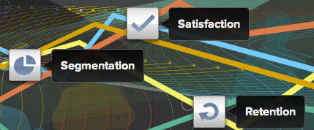

Big Data Transforms Experience Analytics
Gained competitive advantages:
Reduced customer churn
Improved targeting and response rates
Lower costs
Increased customer lifetime value and profitability
“Greenplum can pull data at lightning speed helping our customers make real-time decisions.”
Notes:
http://www.greenplum.com/sites/default/files/ClickFox_case_study_0.pdf

Slide 23















And It’s Open Too
Discovix
Notes:
Greenplum is working with an amazing group of customers to help them pursue business value from Analytics and participate in this era of Big Data. These industry leaders and innovative thinkers are doing extraordinary things with our platform.
Our expansive partner network ensures you protect your existing investments while having the opportunity to leverage the best available technology
Greenplum is proud to work with this extraordinary customer and partner ecosystem.

Slide 24



Greenplum Deployment Choice, Flexibility
Data Computing Appliance
Choose Greenplum Database And/Or Hadoop Modules In ¼ Rack Increments
Scale By Adding Your Choice Of Additional Modules
Fast Time To Value
Greenplum Software Solutions
Greenplum Database, Hadoop, & Chorus On Your X86 Hardware
Flexibility For Any Workload Or Environment
Perpetual Or Subscription Licenses

Slide 25
The Journey To Big Data
1
2
All Data Faster Answers
Elastic & Scalable
Data Science Collaboration
Self-Service
Agile Process & Tools
Analytic Engines
Analytics Engines
Analytic Productivity Platform
Cloud Infrastructure
Big Data Infrastructure Technology Focus
Agile Analytics People & Productivity Focus
Notes:
The second phase of the journey to big data involves changing the process that is used to gain insight from your information.
It moves from analytics to data science with the creation of a new role – the data scientist. This person leads a cross-functional team to gain insights from data. Data Science requires a high degree of collaboration to accelerate insights – sharing data sources and what people find.
It also requires self-service access to create new data marts ensuring that IT is serving the needs of the business with automation, rather than intervention.

Slide 26





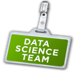

Greenplum: Not Just About Technology
Empowering data science teams to drive big data analytics success
Data Science Programs
Collaborating with Stanford and UC Berkely
Data Science Practice
In-house PhDs with analytics expertise
Community Investment
Greenplum Analytic Workbench & Data Science Summits
Notes:
You have heard us say Greenplum not just a database, but guess what, it’s also, Greenplum, not just about technology.
Data science teams are an emerging practice that are making amazing things happen on big data on behalf of their organizations.
Our commitment to the future of data science is represented by our collaboration with Stanford and Berkeley on data scientist curriculums and programs.
We also have our own amazing data scientist practice with leading PHDs that have expertise in leading analytic tools. This team works every day with our customers advancing their projects and enabling new things from data.
And it’s investment in the community. We recently announced, with the help of several partners, a 1000 node Hadoop cluster called the Greenplum Analytic workbench for Hadoop. The only one of its kind in the industry. We will always have community editions of our software available for free. And we continue to invest in the practice by creating an publicizing events like the data scientist summits.

Slide 27


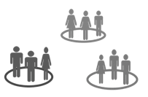
Old Analytic Processes
Administrator Bottleneck
Reactive, Unresponsive
Opaque, No Collaboration
Notes:
We still have some fundamental challenges n front of that involve people and the analytic processes. What our customers have told us that in the old way, their data scientists would ask IT for data sets and the process was so time consuming that by the time the data arrived, it was too late. And often, analysts themselves would work in isolation. They didn’t share best practices with others that other analysts would have to always “re-invent the wheel”

Slide 28

Shouldn’t Collaboration Work More Like Facebook ?
Notes:
Why can analytic processes be like Facebook where we can always collaborate in real-time? Why can’t we create a collaborative environment where we are learning from each other and participating in analysis of large data sets and sharing results in real time?

Slide 29


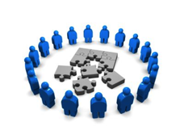
New Analytic Processes Are Different
Self-Service
Iterative, Agile
Transparent, Real Time Collaboration
Notes:
And this new analytic environment is what we offer. This new environment allows analysts to self-service provision sandbox environments where in they can analyze data sets in real time. The environment is iterative, agile and the entire team can view the data sets and collaborate, interact and respond with others in real-time.

Slide 30





The Organization Must Evolve From This…
Line Of Business
User
Business Intelligence
Analyst
Business
I.T. Department
Database
Administrator
Notes:
This collaborative approach will force organization to evolve from the traditional model of having a barrier between IT and Business/Analysts to (next slide)

Slide 31


To A Data Science Team
Line Of Business
User
Business
Intelligence
Analysts
Data
Scientists
Data Platform
Administrator
Notes:
… This more collaborative relationship among various members of the data science team. In the next decade, we will see the emergence of the data scientist which combines the skills of a computer scientist, mathematician and BI analyst which are all skills required in Big Data.
Greenplum Chrous allows members of the data science team to publish and share their data sources and their insights.
You can search for other’s work, post your own work with notes and comment on the work of others.

Slide 32


Greenplum Chorus Makes It Possible
Project Workspaces
Data Analysis
Publish and Iterate
Explore the Data
Collaboration
Notes:
Greenplum Chrous allows members of the data science team to publish and share their data sources and their insights.
You can search for other’s work, post your own work with notes and comment on the work of others.
http://www.newsorganizer.com/article/building-a-bridge-along-the-en-3f94acdb7b925dff2568da4fdb1ce511/
“Producing analytic insights with big data is definitely a team sport – to deliver insight requires the cooperation of a lot of folks to figure out how or why people are leaving a web site, for example.”

Slide 33



EMC Greenplum Delivers Agile Analytics
Self-Service
Iterative, Agile
Transparent, Real-time Collaboration
Structured & Unstructured Data
Analyze Petabytes Of Current Data
Virtual, Scale Out Architecture

Slide 34
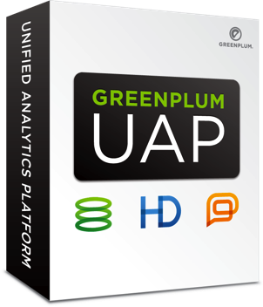
In A Single Unified Analytics Platform
Self-Service
Iterative, Agile
Transparent, Real-time Collaboration
Structured & Unstructured Data
Analyze Petabytes Of Current Data
Virtual, Scale Out Architecture

Slide 35
The Journey To Big Data
1
2
3
All Data Faster Answers
Elastic & Scalable
Data Science Collaboration
Self-Service
Real Time Decisions
New Applications
Data Monetization
Big Data Enabled Apps
Agile Process & Tools
Analytic Engines
Analytics Engines
Analytic Productivity Platform
Cloud Infrastructure
Big Data Infrastructure Technology Focus
Agile Analytics People & Productivity Focus
Predictive Enterprise Application Focus
Notes:
After phase 2, you have your data science team and your new big data infrastructure, the next step is about scaling the value of big data everywhere.
The final step in the Journey To Big Data is embed big data into applications.

Slide 36
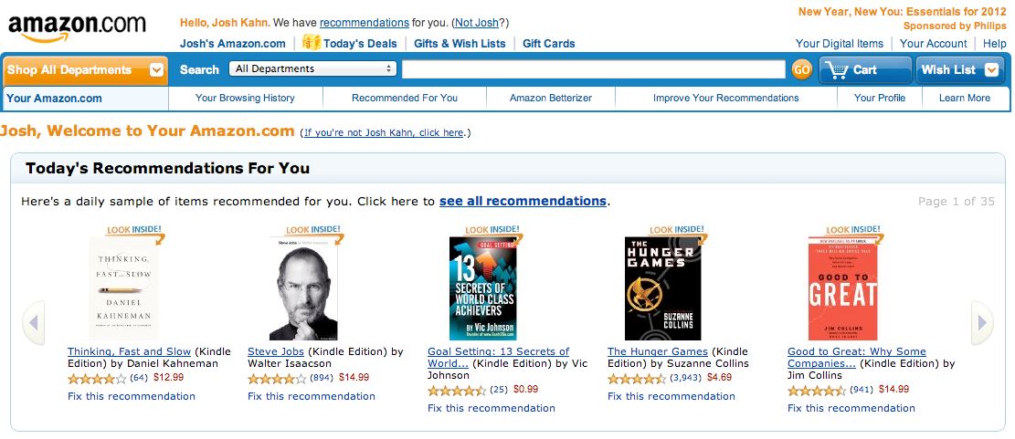
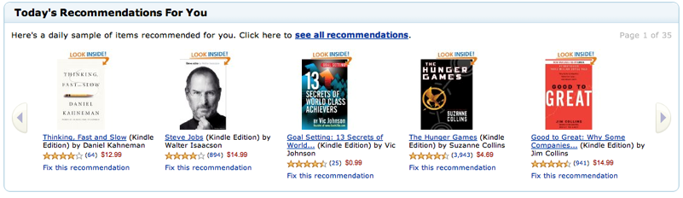
Predictive. Embedded.
Notes:
The final thing we want to do in the realm of Big Data is we want to deliver Big Data at the point in time in which it is most impactful. Like Amazon, you get recommendations not the following day, but on the same day you make a purchase. We want to do the same in business applications—every time a business decision-maker is making a decision, we want them to have the data available.

Slide 37

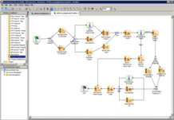
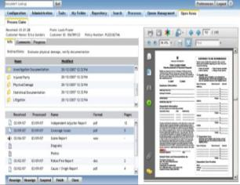
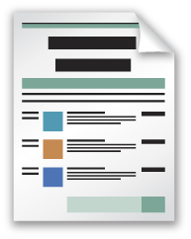
xCP: Driving Insight To Action
Easy To Build
A Tool For Non-Programmers!
Drag & Drop Process Modeling
Better, Faster Decisions
Deliver The Latest Data
Enable Contextual Decisions
Complete Audit Trail
Keep IT Audit Happy!
Reduce Information Risk
Notes:
Talk to Slide on XCP
Taking standard for doc mgmt Documentum making it better
Later today in Rick Devenuti's keynote, announce and demo a service offering: EMC OnDemand.
EMC OnDemand is built on a revolutionary new cloud provisioning architecture called VCUBE
Paul Maritz of VMW will cover in his keynote tomorrow
1st products on EMC OnDemand: Enterprise Content Management products from IIG
But I started discussion with Big-Data and need to take Action
Next: Demo
BELOW ARE NOTES ONLY, NOT FOR MONITOR

Slide 38



Get Big Data Ready
Advisory Services Build Strategies That Drive Competitive Advantage
Analytic Engines
Analytics Engines
Cloud Infrastructure
Big Data Architecture Integrate New Technologies With Existing Systems
Data Quality & Value
Ascertain Level of Data Relevancy
Business
Identify The “Right” Business Opportunity
Notes:
EMC Consulting's Big Data Advisory Service is designed to guide you along your Big Data Journey
First, we identify the “Right” Business Opportunity. Start by making the business solution front and foremost – what will big data do to enable competitive advantage?
Business leaders don’t want yet more technology, they want solutions. And they want solutions that drive competitive advantage. Involve the business stakeholders on day one of this journey so that you select the best-fit, priority business opportunity.
We get your IT and business leaders working together to help you envision where and how big data can transform your business
Ascertain the Level of Data Readiness. Do you have the right data to support your key big data business initiatives? What is the quality of that data to drive key business decisions?
We help you determine the business value, or relevancy, of your data, and build out a Data Quality Scorecard so that you can constantly monitor your data assets
Integrate New Technologies With Existing Systems. Create a big data architecture using an agile data platform. Plan for fast ingestion of new structured and unstructured big data sources. Ensure extensibility to accommodate change. Operationalize by integrating into your existing data warehouse and BI systems.
At the end of the engagement, you will be presented with a roadmap which provides a phased implementation plan with recommended next steps in the big data transformational journey, centered around your organization’s best-fit, priority business opportunity.

Slide 39

Big Data Transforms Relationship Management
Integrate social media data with existing CRM system to:
Improve client product recommendations
Improve prospecting with “like” and cohort analysis
Uncover new product and market opportunities and trends
EMC Consulting engaged in Big Data quality, integration and warehousing project
Notes:
Large global finance and credit services company is launching a comprehensive big data quality, integration, and warehousing project to uncover new customer and product insights for competitive advantage. EMC Consulting is helping them interpret content from social media and internal unstructured data sources to improve product offerings, understand customer trends and insights, identify highly-qualified sales prospects and identify new “white space” market opportunities.

Slide 40
The Big Data Stack
1
2
3
All Data Faster Answers
Elastic & Scalable
Data Science Collaboration
Self-Service
Real Time Decisions
New Applications
Data Monetization
Predictions Built-In
Data At The Point Of Decision
Scale Big Data Insights
Big Data Enabled Apps
Self-Service
Iterative, Agile
Transparent, Real-time Collaboration
Agile Process & Tools
Analytic Engines
Analytics Engines
Analytic Productivity Platform
Structured & Unstructured Data
Analyze Petabytes Of Current Data
Virtual, Scale Out Architecture
Cloud Infrastructure
Big Data Infrastructure Technology Focus
Agile Analytics People & Productivity Focus
Predictive Enterprise Application Focus
Notes:
The new approach to data encompasses the three things that I just spoke about.
It requires a new approach to storage and analytics enabling you to store and access all data sources, both structure and unstructured deployed on a storage foundation that is elastic and provides seemingly infinite scale. You need to establish this infrastructure and analytics architecture first.
Second, you need to evolve your organization to take advantage of agile processes and tools. The new data scientist team can now collaborate, share insights and learn from each other all in real-time
Third, that the analytics become embedded in your enterprise applications so that you can trigger business processes that act on the insight that you’ve derived. In essence the new mission critical apps will be Big Data Enabled Applications.

Slide 41
Summary and Next Steps
Big Data is Transforming Business
Big Data Requires A Different Approach
Technology, People & Process, Applications
Transform Your People
Learn about EMC’s Data Science and Big Data Analytics Training
Become Big Data Ready
Engage with EMC Consulting Global Advisory Service
Notes:
Become Big Data Ready. Engage with EMC Consulting’s Big Data Advisory Service.
Transform Your People With EMC’s Data Science and Big Data Analytics Training and Certification.

Slide 42
Notes:
Thank you.

Slide 43
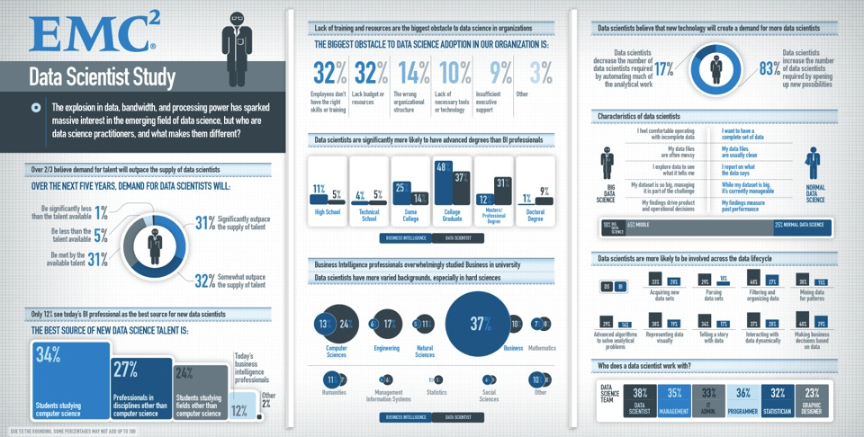
Notes:
While this chart is overly busy, it is chalk full of relevant insights that will impact how you hire, train and build out new analytic assets in your organization – the Data Scientist.
31% of study participants believe that the demand for Data Scientist will outpace their ability to hire and train Data Scientists
32% of the study participants believe that their current organization lacks the skills and training to fulfill the demand for Data Scientists; current employees lack the right skills and training
And by a ratio of 31% to 12%, study participants believe that the amount of professional development and degrees exceeds what is being provided today to their current BI and data warehouse specialists.

Slide 44

Data Science Training and Certification
Practical Foundation for Data Science
Data Science and Big Data Analytics Course
Introduction to Big Data Analytics
Big Data Analytics Lifecycle
Review of Basic Data Analytics Methods and “R” + Lab
Advanced Analytics and Statistical Modeling for Big Data: Theory and Methods + Lab
Advanced Analytics & Statistical Modeling for Big Data: Technology & Tools + Lab
Big Data Analytics Lifecycle Lab
Notes:
EMC Educational Services is the first to offer a Data Scientist certification program
The purpose of this initial class to is prepare BI and DWH specialists to become active participants in a Data Science engagement
The class provides hands-on experience with:
Advanced analytics using R and RStudio
In-database analytics using MADlib
SQL exercises using Postgres
Introduction to Hadoop

Slide 45

Getting Started: Greenplum Analytics Labs
Packaged solutions that produce business value and actionable results
Accelerate analytics capabilities on your data with your analysts
Leverage the expertise of Greenplum’s Data Scientists
Establish a strategic vision for analytics development
Notes:
That brings us to what do you do next and how do we work together and explore how to get value from your data. For us the way to get started is a Greenplum Analytics lab. This is everything we have talked about today. It is the combination of our Unified analytics platform, and our experts, the data scientists, coming into your organization and working on something that is real. Your data, with your team, doing a project and extracting real value out of it. We like to think of this as the Big Data POC. Unlike a Data Warehousing POC, this is not about just about speeds and feeds, this is about context and something that is relevant to your business and we want to come in and prove it to you. That is a Greenplum Analytics lab.

